Slide 1


Geometry and Editing
Esri Developer Summit
March 8–11, 2016 | Palm Springs, CA
Narelle Chedzey

Slide 2

ArcGIS.Core.Geometry API
Similar to ArcGIS Runtime API.
Contains key classes and enumerations defining geometry types such as MapPoint, MultiPoint, Envelope, Polyline, Polygon, and SpatialReference.
Containers that house collections of the geometries as PointCollection, PartCollection and SegmentCollection.
Support for straight lines, Bezier curves, circular arcs.

Slide 3
ArcGIS.Core.Geometry API
Geometry objects are immutable – once created, their content cannot be altered.
Simpler to understand.
No need for event handlers to deal with changing geometries.
Avoid potential concurrency issues in the multithreaded environment of ArcGIS Pro.
Use builder classes to construct and manipulate geometries objects.
There is a builder for every geometry type.
Builders are run on the MCT.

Slide 4
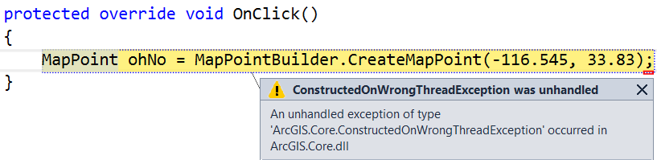
Reminder
Geometry Builders and GeometryEngine operations can only be executed on the CIM thread.
Must use QueuedTask.Run to get code execution to the CIM thread.
QueuedTask.Run(…)
Or

Slide 5
GeometryBuilders
var mapPointBuilder = new MapPointBuilder(SpatialReferences.WGS84);
mapPointBuilder.X = -117.18;
mapPointBuilder.Y = 34.06;
MapPoint currentEsriHQ = mapPointBuilder.ToGeometry();
mapPointBuilder.X = -117.84;
mapPointBuilder.Y = 33.57;
MapPoint desiredEsriHQ = mapPointBuilder.ToGeometry();
// build the straight line from the points
var lineBuilder = new LineBuilder(currentEsriHQ, desiredEsriHQ);
LineSegment line = lineBuilder.ToSegment();
// build the polyline from the line segment
var polylineBuilder = new PolylineBuilder(line);
Polyline Polyline = polylineBuilder.ToGeometry();
Notes:
Perhaps segue to snippets on the git….

Slide 6
GeometryBuilders (continued)
Builders also have static convenience methods.
MapPoint pt1 = MapPointBuilder.CreateMapPoint(1.0, 1.0, SpatialReferences.WGS84);
MapPoint pt2 = MapPointBuilder.CreateMapPoint(1.0, 2.0, SpatialReferences.WGS84);
MapPoint pt3 = MapPointBuilder.CreateMapPoint(2.0, 2.0, SpatialReferences.WGS84);
MapPoint pt4 = MapPointBuilder.CreateMapPoint(2.0, 1.0, SpatialReferences.WGS84);
List<MapPoint> list = new List<MapPoint>();
list.Add(pt1);
list.Add(pt2);
list.Add(pt3);
list.Add(pt4);
Polygon polygon = PolygonBuilder.CreatePolygon(list);
Notes:
Contrast with Polygon in ArcObjects – typically constructed using either ISegmentCollection or IPointCollection.
Point out all the examples that are available on github as snippets

Slide 7
GeometryEngine
Utility class for performing geometric operations. Modeled after Runtime.
Static methods perform manipulations such as buffer, cut, clip, offset, union, etc.
QueuedTask.Run(() =>
{
var esriHQ = MapPointBuilder.CreateMapPoint(-117.18, 34.06,
SpatialReferenceBuilder.CreateSpatialReference(4326));
var aroundRedlandsCampus = GeometryEngine.Buffer(esriHQ, 0.035);
});
QueuedTask.Run(() =>
{
MapPoint pt1 = MapPointBuilder.CreateMapPoint(1.0, 1.0);
MapPoint pt2 = MapPointBuilder.CreateMapPoint(2.0, 2.5);
Geometry geometry = GeometryEngine.Union(pt1, pt2);
Multipoint multipoint = geometry as Multipoint;
});
Notes:
Note use of QueuedTask.Run. Spatial operators (buffer, cut, clip, offset, union, etc), relationship operators (touch, crosses, within, contains), projection and transformation

Slide 8
ArcGIS.Desktop.Editing API
Provides access to the edit templates and the sketch geometry.
Create custom sketch tools and construction tools
Sketch tools modify the geometry of existing features
Construction tools create new features
Edit events
EditCompletedEvent captures creates, modifies, and deletes across all layers/tables.
RowEvents captures creates, modifies, and deletes per layer/table.
Contains inspector class for streamlined attribute editing.
Notes:
There are also RowEvents for changes to rows

Slide 9
Edit Operations
All data manipulations should be executed as part of an edit operation.
Adds to the undo stack.
An edit operation can encapsulate multiple edits.
// Create an edit operation
var createOperation = new EditOperation();
createOperation.Name = "My first edit";
var template = ArcGIS.Desktop.Editing.Templates.EditingTemplate.Current;
// Queue feature creation
createOperation.Create(template, geometry);
createOperation.Create(template, anotherGeometry);
// Execute the operation
return createOperation.ExecuteAsync();

Slide 10
Save Edits
Project.Current.SaveEditsAsync()
Project.Current.DiscardEditsAsync()
if (Project.Current.HasEdits)
await Project.Current.SaveEditsAsync();
Notes:
Show SketchToolEditDemo – use of feature.Store vs EditOperation.Execute

Slide 11
Edit Templates
// get the current template
var myTemplate = ArcGIS.Desktop.Editing.Templates.EditingTemplate.Current;
// get templates by name
ArcGIS.Desktop.Framework.Threading.Tasks.QueuedTask.Run(() =>
{
var map = MapView.Active.Map;
var mainTemplate = map.FindLayers("main").First().GetTemplate("Distribution");
var mhTemplate = map.FindLayers("Manhole").First().GetTemplate("Active");
// activate the default tool and make template current
mhTemplate.ActivateDefaultToolAsync();
});
Notes:
Important for construction tools

Slide 12
Construction Tool
internal class SimpleConstructionTool : MapTool
{
public SimpleConstructionTool ()
{
IsSketchTool = true;
UseSnapping = true;
SketchType = SketchGeometryType.Point;
}
/// Called when the sketch finishes. This is where we will create the sketch operation and then execute it.
protected override Task<bool> OnSketchCompleteAsync(Geometry geometry)
{
if (CurrentTemplate == null || geometry == null)
return Task.FromResult(false);
// Create an edit operation
var createOperation = new EditOperation();
createOperation.Name = string.Format("Create {0}", CurrentTemplate.Layer.Name);
createOperation.SelectNewFeatures = true;
createOperation.Create(CurrentTemplate, geometry);
return createOperation.ExecuteAsync();
}
}

Slide 13
Construction Tool (continued)
<controls>
<tool id="SimpleConstructionTool" categoryRefID="esri_editing_construction_point"
caption="SimpleConstructionTool"
className="SimpleConstructionTool" loadOnClick="true"
smallImage="Images\GenericButtonRed16.png" largeImage="Images\GenericButtonRed32.png">
<tooltip heading="ArcGIS Pro SDK">Default construction tool.<disabledText /></tooltip>
</tool>
<controls>
Change construction tool type by modifying both the DAML and the SketchType
Supported categories are
esri_editing_construction_point
esri_editing_construction_polyline
esri_editing_construction_polygon
esri_editing_construction_multipoint
Notes:
categoryRefID what type of layer will this tool be associated with.

Slide 14
Demo
Notes:
Construction tool, split, context menus

Slide 15
Setting a Construction Tool as the Default Tool on a Template
We must use the Template Definition from the CIM
Can only change persisted templates
Must define a GUID for the tool in the Config.daml
private Task ChangeTemplateDefaultTool(FeatureLayer flayer, string toolProgID,
string templateName) {
return QueuedTask.Run(() => {
var template = flayer.GetTemplate(templateName) as EditingTemplate;
var layerDef = flayer.GetDefinition() as CIMFeatureLayer;
if (template != null && !layerDef.AutoGenerateFeatureTemplates) {
if (template.DefaultToolID != this.ID) {
var templateDef = template.GetDefinition();
templateDef.ToolProgID = toolProgID;//This is a guid!
template.SetDefinition(templateDef);
}
}
});
}
Notes:
Not really a supported workflow but is the only way at 1.1, 1.2. layerDef.AutoGenerateFeatureTemplates must be false
Demo – Update NewNotesTool “Thick Line 1”
<tool id="TestConstructionTool_CreateDensifiedLineTool" categoryRefID="esri_editing_construction_polyline" ….>
<tooltip heading="">Tooltip text<disabledText /></tooltip>
<content guid="e58239b3-9c69-49e5-ad4d-bb2ba29ff3ea"/>
</tool>

Slide 16
Sketch Tool
<controls>
<tool id="SimpleSketchTool" caption="Simple Sketch Tool" loadOnClick="true"
className=“SimpleSketchTool" largeImage="Images\GenericButtonRed32.png">
<tooltip heading="Sketch">Sketch Tool.<disabledText /></tooltip>
</tool>
</controls>
internal class SimpleSketchTool : MapTool {
public SimpleSketchTool() {
IsSketchTool = true;
SketchType = SketchGeometryType.Line;
SketchOutputMode = SketchOutputMode.Map;
}
// Called when the sketch finishes.
protected override Task<bool> OnSketchCompleteAsync(Geometry geometry) {
//Run on MCT
return QueuedTask.Run(() => {
// TODO - perform the sketch operation
}
}
}
Notes:
Derived from Map Tool. Provides a SketchType and a callback for when the sketch completes.

Slide 17
Sketch Tool (continued)
Sketch accessed “in-progress” from override OnSketchModifiedAsync
protected override async Task<bool> OnSketchModifiedAsync() {
var sketch = await this.GetCurrentSketchAsync();
//Manipulate the sketch in progress....
}
}
Use
Task<Geometry> ActiveMapView.GetCurrentSketchAsync()
Task ActiveMapView.SetCurrentSketchAsync(Geometry geometry)
Notes:
UseSnapping = true to effect the Sketch with snapping settings

Slide 18
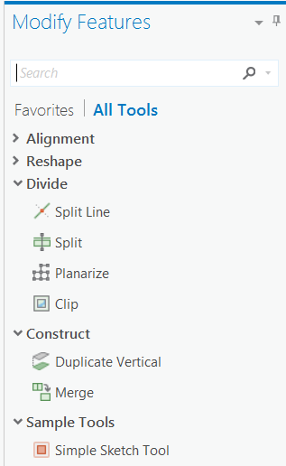
Sketch Tool (continued)
To add the sketch tool to the Modify Features pane
Set categoryRefID attribute to “esri_editing_CommandList”
Set group attribute in content element
<controls>
<tool id="SimpleSketchTool" caption="Simple Sketch Tool" loadOnClick="true"
className=“SimpleSketchTool" smallImage="Images\GenericButtonRed16.png"
largeImage="Images\GenericButtonRed32.png"
categoryRefID="esri_editing_CommandList">
<tooltip heading="Sketch">Sketch Tool.<disabledText /></tooltip>
<content L_group="Sample Tools" />
</tool>
</controls>
Notes:
Demo a sketch tool and edit the DAML

Slide 19
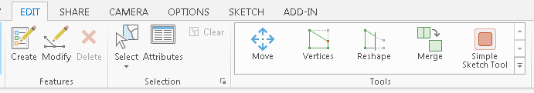
Sketch Tool (continued)
To add the sketch tool to the Edit Tools gallery
Set values for gallery2d and gallery3d attributes in content element
<controls>
<tool id="SimpleSketchTool" caption="Simple Sketch Tool" loadOnClick="true"
className=“SimpleSketchTool" smallImage="Images\GenericButtonRed16.png"
largeImage="Images\GenericButtonRed32.png">
<tooltip heading="Sketch">Sketch Tool.<disabledText /></tooltip>
<content gallery2d="true" gallery3d="false"/>
</tool>
</controls>
Notes:
SketchToolEditDemo 2 – add to the daml to the Config.daml to add it to the Modify features dockpane and gallery 2d.

Slide 20
Demo
Notes:
SketchToolEditDemo 1 – sketch tool - add the daml to the Config.daml to add it to the Modify features dockpane and gallery 2d.

Slide 21
Modify sketch context menu
<updateModule refID="esri_editing_EditingModule">
<menus>
<updateMenu refID="esri_editing_SketchContextMenu">
<insertButton refID="EditingExercisesSolution_DensifyButton" separator="true" />
</updateMenu>
</menus>
</updateModule>
Notes:
Use esri_editing_SketchContextMenu id to modify the sketch context menu

Slide 22
Events
EditCompletedEvent captures creates, modifies, and deletes across all layers/tables.
Event occurs after the operation. No option to cancel the edit.
public void SetupEvents()
{
var editComplete = EditCompletedEvent.Subscribe(onEditComplete);
}
protected Task onEditComplete(EditCompletedEventArgs args)
{
IReadOnlyDictionary<MapMember, IReadOnlyCollection<long>> creates = args.Creates;
IReadOnlyDictionary<MapMember, IReadOnlyCollection<long>> modifies = args.Modifies;
IReadOnlyDictionary<MapMember, IReadOnlyCollection<long>> deletes = args.Deletes;
foreach (var item in creates)
{
MapMember layer = item.Key;
IReadOnlyCollection<long> oids = item.Value;
// do something
}
return Task.FromResult(0);
}
Notes:
Can have x number of entries in creates, modifies, and deletes.

Slide 23
Events (continued)
RowCreatedEvent, RowChangedEvent, RowDeletedEvent captures creates, modifies, and deletes per layer/table.
Event occurs during the edit operation. Allows the option of cancelling the edit.
public void SetupEvents(FeatureLayer featureLayer)
{
if (featureLayer == null) return;
QueuedTask.Run(() =>
{
RowChangedEvent.Subscribe(OnRowChanged, featureLayer.GetTable());
});
}
protected void OnRowChanged(RowChangedEventArgs args)
{
ArcGIS.Core.Data.Row row = args.Row;
string value = row["fieldName"].ToString();
if (!value.StartsWith("123"))
args.CancelEdit("This is a bad attribute. Try again.");
}

Slide 24
Inspector
Access and update attributes.
Get schema information about a layer.
Use as Embeddable control
Corresponds to control on Attributes window.

Slide 25
Inspector – Update Attributes
QueuedTask.Run(() =>
{
//Get the geometry of the selected feature.
var selectedFeatures = MapView.Active.Map.GetSelection();
var theInspector = new Inspector();
theInspector.Load(selectedFeatures.Keys.First(), selectedFeatures.Values.First());
var selGeom = theInspector.Shape;
//var extPolyline = do some geometry operation.
//Set the new geometry back on the feature
theInspector.Shape = extPolyline;
//Update an attribute value
theInspector["RouteNumber"] = 42;
//Create and execute the edit operation
var op = new EditOperation();
op.Name = "Extend";
op.Modify(theInspector);
op.Execute();
});
Notes:
Op.Modify wraps it in an edit operation.

Slide 26
Inspector – Schema Information
FeatureLayer featureLayer = MapView.Active.GetSelectedLayers().OfType<FeatureLayer>().FirstOrDefault();
var theInspector = new Inspector();
theInspector.LoadSchema(featureLayer);
IEnumerable<ArcGIS.Desktop.Editing.Attributes.Attribute> attributes = theInspector;
foreach (var att in attributes)
{
// ignore blob, raster, geometry fields
if ((att.FieldType != ArcGIS.Core.Data.FieldType.Blob) &&
(att.FieldType != ArcGIS.Core.Data.FieldType.Raster) &&
(att.FieldType != ArcGIS.Core.Data.FieldType.Geometry))
{
// att.FieldName
// att.FieldAlias
}
}

Slide 27
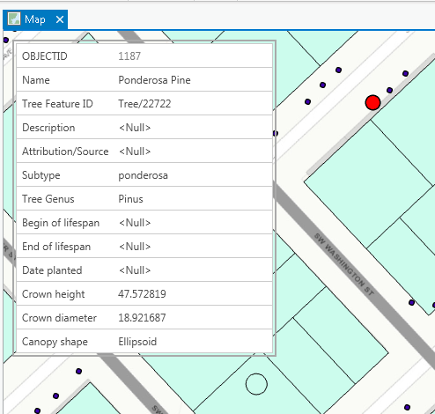
Inspector – EmbeddableControl
if (_theInspector == null)
{
_theInspector = new Inspector();
var tuple = _theInspector.CreateEmbeddableControl();
_vm.InspectorView = tuple.Item2;
_vm.InspectorViewModel = tuple.Item1;
}
<Grid MaxHeight="400" MaxWidth="300">
<Border BorderBrush="DarkGray" BorderThickness="2">
<DockPanel LastChildFill="true" Margin="2">
<ContentPresenter Content="{Binding InspectorView}“/>
</DockPanel>
</Border>
</Grid>
Notes:
Demo…. favoriteQueries.aprx

Slide 28




